Slide 1

L.L.A.M.A. Inc. (Libraries, Life, and Medical Assistance)
Empowering communities with knowledge and care

Slide 2
L.L.A.M.A Inc. Libraries, Life, and Medical Assistance
A multifaceted company that wants to help people in different ways.

Slide 3

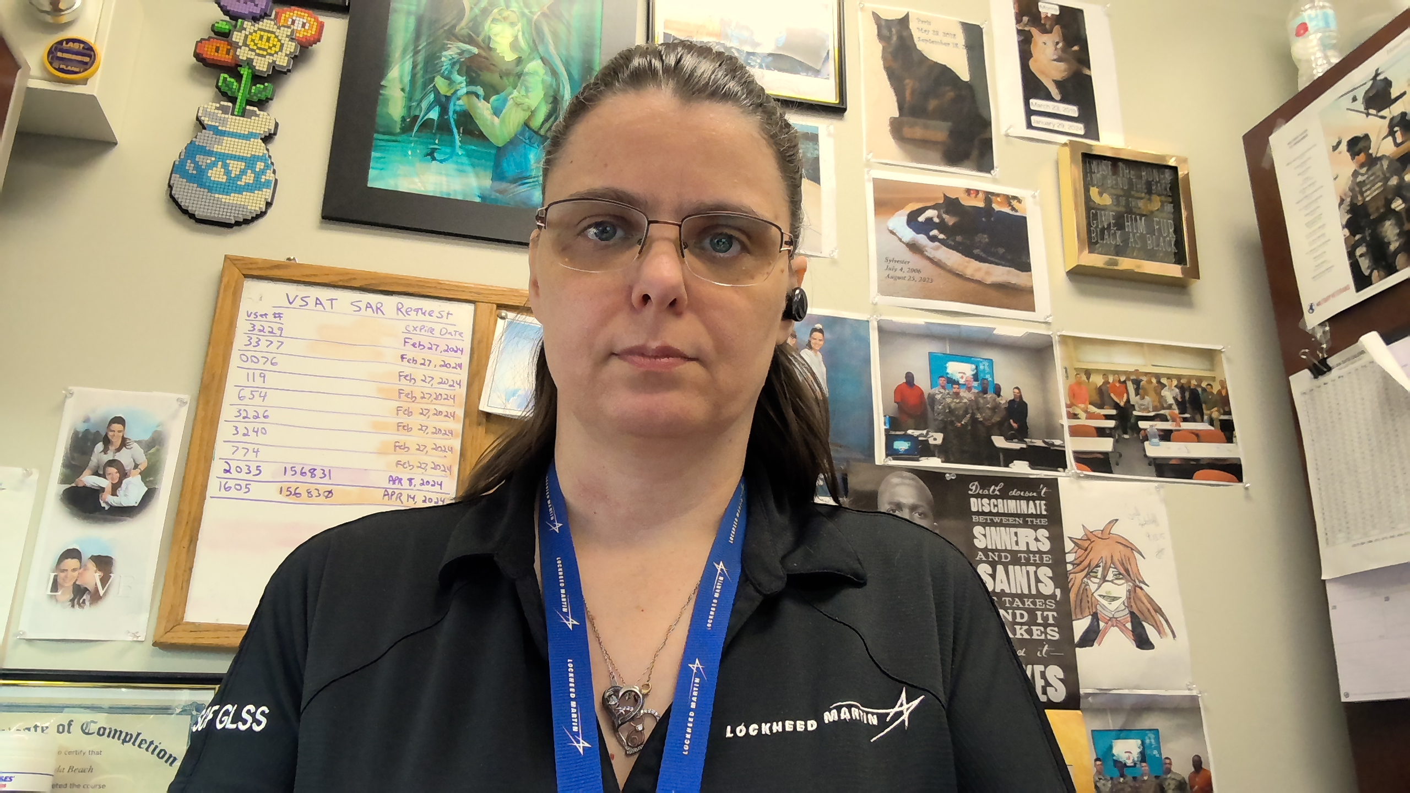


Meet the team
Jonathan Hardwick​​
Brenda Beach
Justin graves​​
Brittany smith

Slide 4

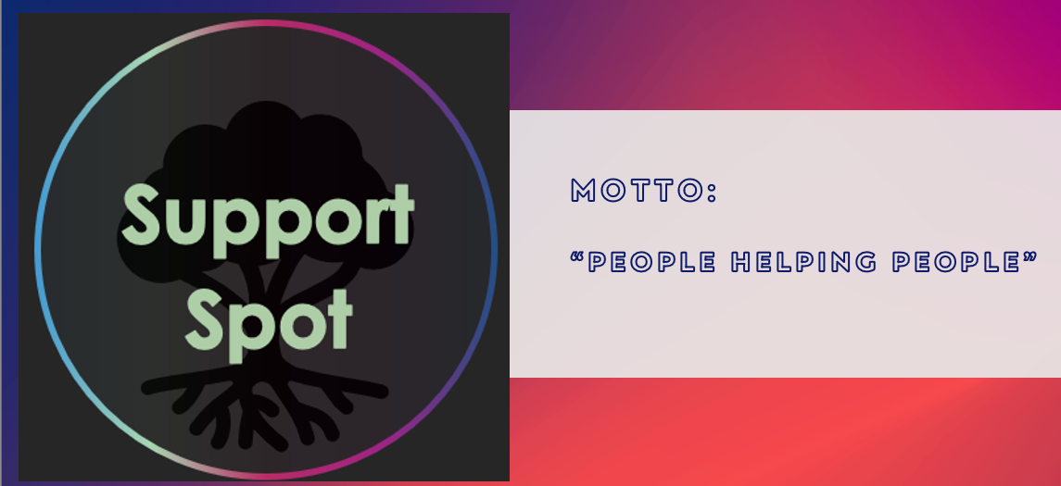
Video Game Library & Sales
Jonathan Hardwick
Brenda Beach
Support Spot
Brittany Smith
Justin Graves

Slide 5

Video Game Library & Sales
Sam has an extensive collection of video games and consoles, and he wants to create a list of his items to determine their potential worth.
Gwen wants to share the joy of her video game collection with others by selling parts of her collection.

Slide 6
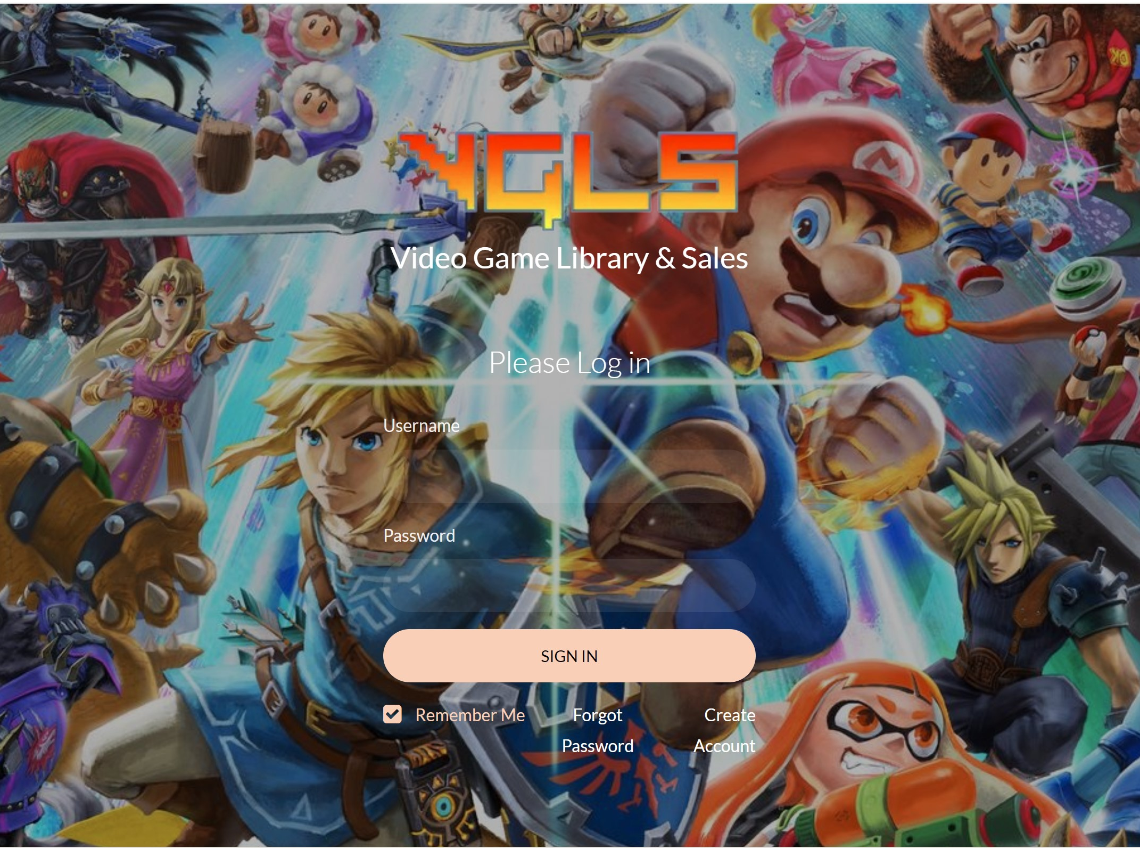
Video Game Library & Sales
User can create an account
Can create a library of all their video games, consoles, and peripherals.

Slide 7
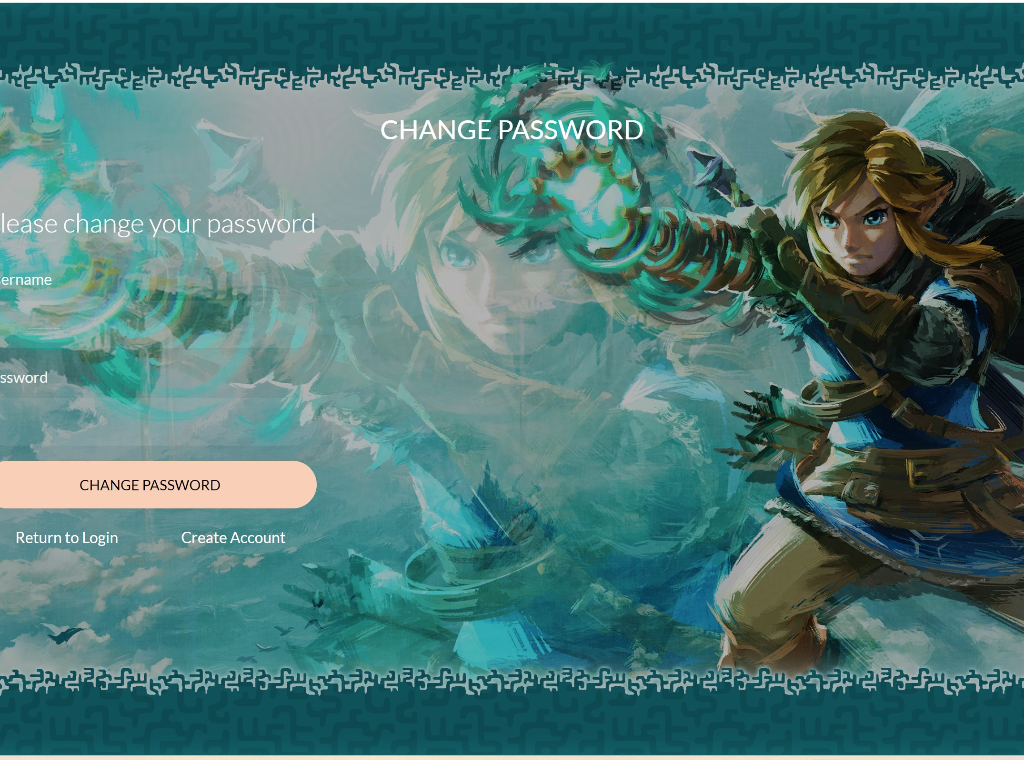
Video Game Library & Sales
If User forgets their password, they can change it.
The user can also change their username under their account information.

Slide 8
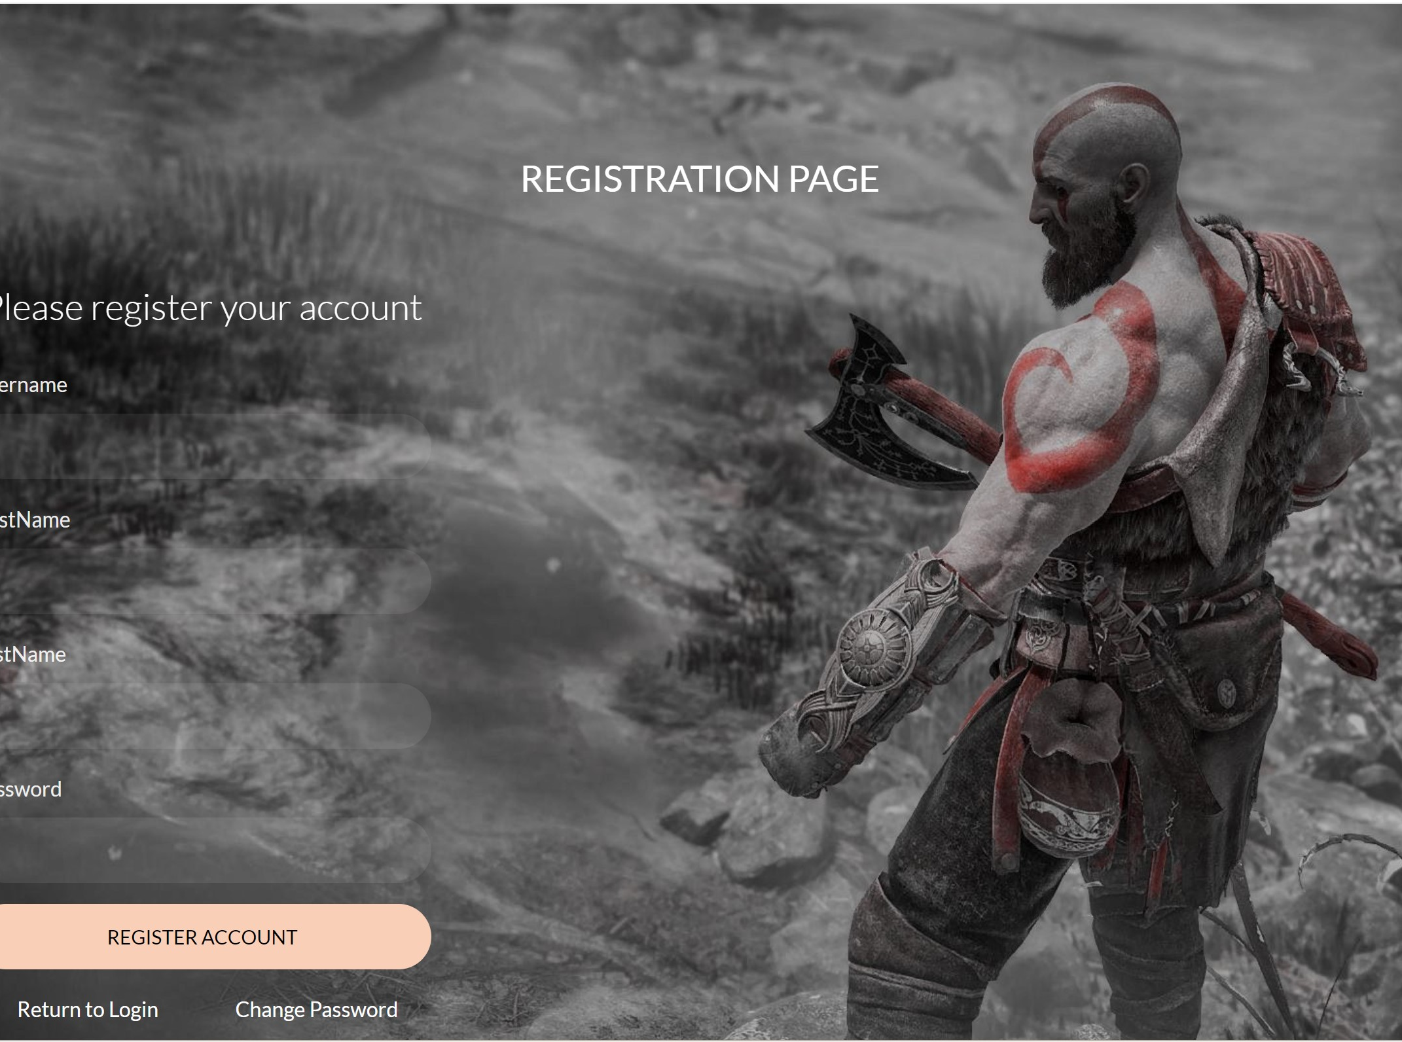
Video Game Library & Sales
Implement web scraping to determine the current price for each item.
The price will then be displayed in the user’s inventory.

Slide 9

Video Game Library & Sales
Future Plans
Allow users to buy and sell items through the website.
Implement LLM to suggest similar video games to users.

Slide 10

Motto: “People Helping People”

Slide 11

The Problem:
Homeless individuals face several unique challenges when trying to get help in their community. There is a lack of stable housing and limited access to services such as mental health/ substance abuse programs. They also have difficulty accessing government assistance programs due to the lack of identification or other documentation.

Slide 12

Meet Ray:
Ray is currently living on the streets and is struggling with mental health/substance abuse issues. He decides to reach out to a social worker for help. They then can create a localized list of resources that can help him on his journey to stable housing and recovery.

Slide 13
solution
Our mission
Target audience
At Support Spot we want to make the process of getting resources easier for people who are struggling with homelessness, substance abuse, and/or food crisis in our community.
People struggling with homelessness, mental illness/ substance abuse and food shortage.
Cost savings
Easy to use
A simple product that gives people the information they need to find the right resources for them.
Reduce costs for the client by having one program they can use to find all resources in our area.

Slide 15

Questions?

